Slide 1
Azure Functions
Mehdi Khaleghian
Notes:
http://news.genius.com/Marc-andreessen-why-software-is-eating-the-world-annotated

Slide 2
What we are going to cover
What is Serverless Computing?
Serverless is an architecture
Players in the market
Azure Serverless offerings
Azure Function App and Functions
Hosting plans
Triggers and Bindings
Demos

Slide 3
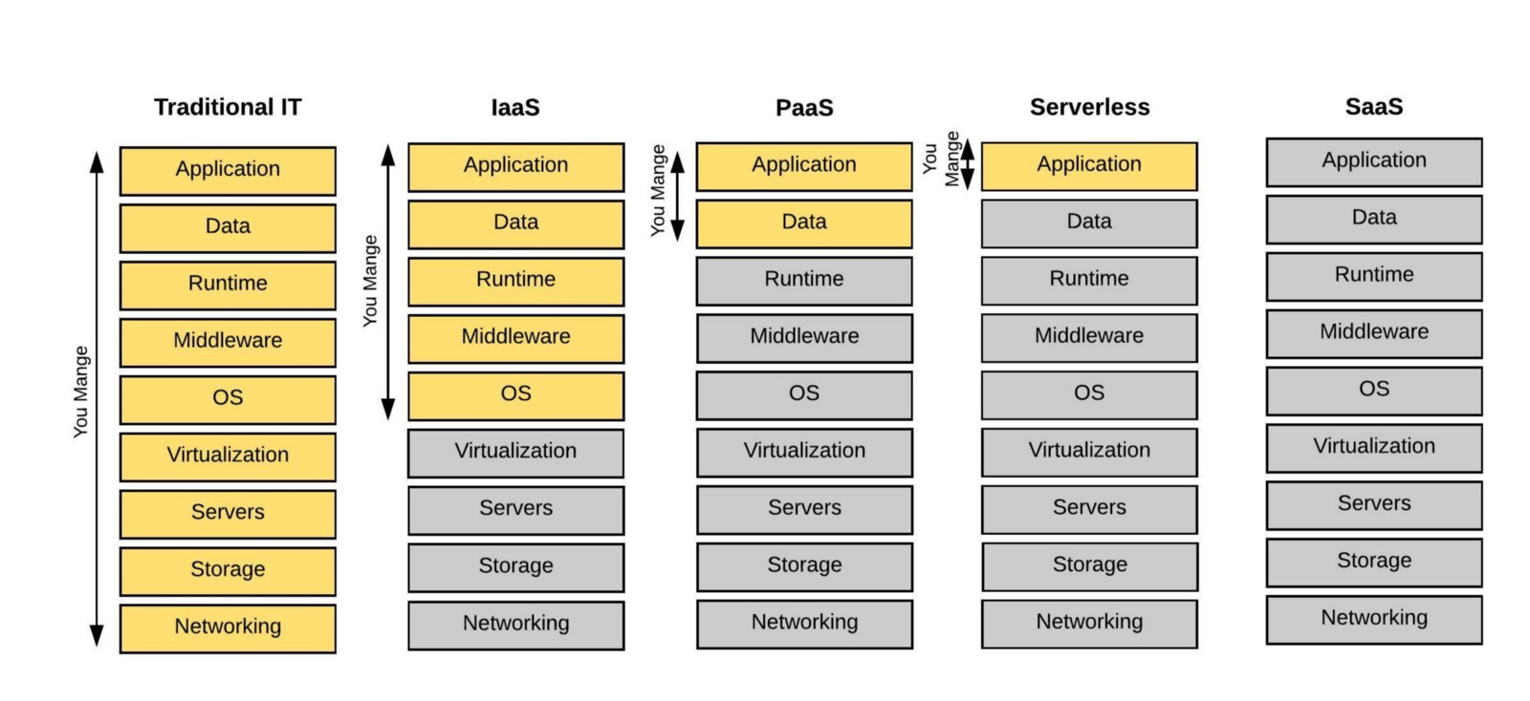
What is serverless?

Slide 4

Serverless is an architecture
For as long as I can remember there’s been a general understanding in the tech community — that the future of computing lies in an internet connected thin-client architecture.
But I think that something else is sneaking up on us, and an alternate future of software architectures is materialising — based on serverless architectures. This future is characterized by rich thick-client applications talking directly to cloud datastores and small cloud-based micro-services for protected workloads & service orchestration.
Sam Kroonenburg
Co-Founder of A Cloud Guru

Slide 5
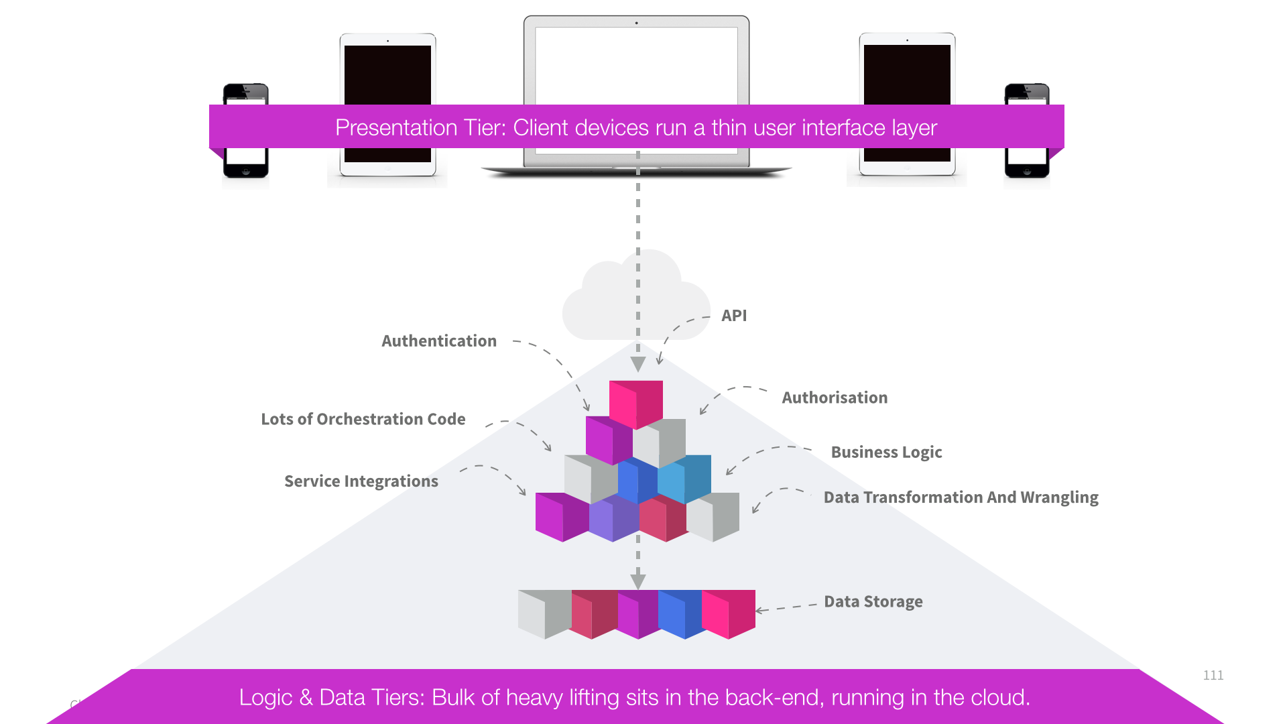
Typical 3-tier architecture
User interface drives function in the backend
Huge Duplication
Need to touch every layer to add new features
Business logic resides on the server-side

Slide 6
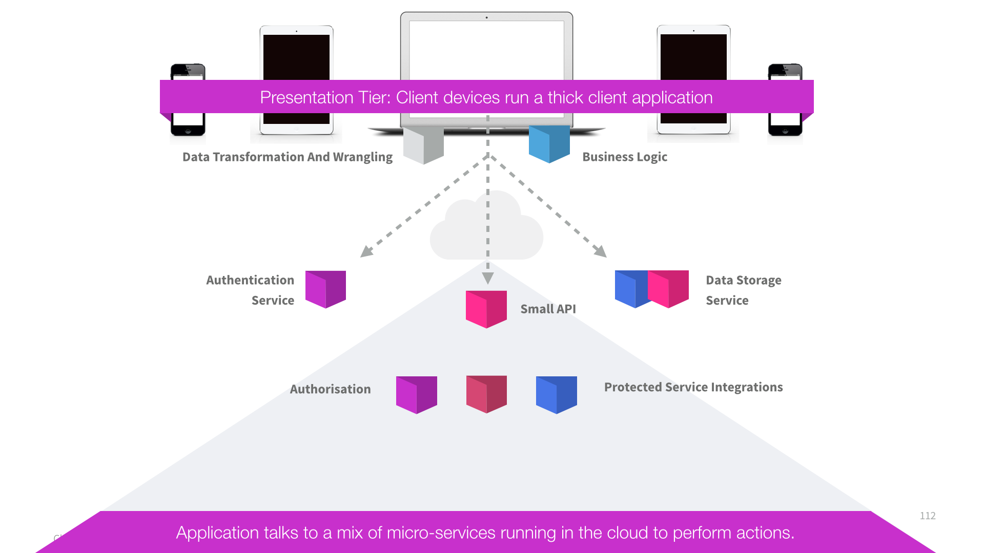
Serverless Architecture
Client devices run a thick client application
UI application contain all of the orchestration logic
UI talk directly to a range of cloud-enabled services
Micro-services perform authentication, storage, notification ect

Slide 7




Serverless Architecture
Serverless Architecture Depends as much as possible on third party applications or services running in the cloud
Often client side is implemented as a single-page web application
Third-party database service
FaaS
Web App (SPA)
Third Party Authentication Service
Notes:
It is not possible to fully depend on third party services for your entire application
In recent years another type of application codes started to emerge
This lets you deploy small functions, snippets of code without managing any servers yourself
So serverless great ideas are
Make use of third party services ie database services, authentication services
And write your own code without the need to manage servers

Slide 8
Benefits
No more managing servers
Focus on what really matters
Automatic Scale
Cost-effectiveness
Rapid Prototyping
Avoid using Infrastructure as a Service (IaaS)
Prefer Platform or Function as a Service
Avoid spending time writing Infrastructure Code
Only write the code that is specific to your business domain
Avoid the need to implement scale out yourself
Additional capacity is automatically provisioned for you
Avoid paying monthly fees for under-utilized servers
Pay only for what you use – minimal cost during prototyping
Avoid slow starts and get quickly to proof of concept
Create a low cost prototype you don’t need to throw away
Notes:
https://azure.microsoft.com/en-au/overview/serverless-computing/

Slide 9
Drawbacks
Third Party Service SLAs
Less Control
Latency
Variable Costs
Immature Tooling
Notes:
Services which you rely on can be temporarily down
You don’t have control over the framework that is in use for example
How long does it take for example for a web api hosted in the cloud to ramp up when it has not been used for some hours
You might get nasty surprises because of the high load which is not coming from paying customers
Relatively new, some of the toolings are still in the new stages but because of good support in the community new improvements are coming on the daily basis

Slide 10
Serverless Hosting Providers
Development Technologies
How much would it cost
Community Support
Documentations available

Slide 11

Amazon AWS Lamda
JavaScript
Node.js
Python
Java
C# and F# (.net Core)
Introduced in 2014
Documentation is comprehensive and always up-to-date
Community is quite large
Has a free tier that allows for one million requests and 400 terabyte-seconds of compute time per month

Slide 12

Microsoft Azure Functions
JavaScript
Node.js
Python
C# and F#
PHP
Bash
Batch
PowerShell
Released preview in March 2016
Support languages that help with DevOps (managing machine, instances etc)
The cost is the lowest when traffic is added to the cost compared to other providers

Slide 13

Google Cloud Functions
Only Supports JavaScript (based on Node.js)
The open beta of Google Cloud Functions was launched in March 2017

Slide 14


Other players
IBM OpenWhisk
Fission.io

Slide 15
Azure Serverless offerings
Azure Functions Serverless Computing
Azure Logic Apps Serverless Workflows
Event Grid Serverless event routing
Notes:
These are wording from an old document

Slide 16
Azure Function App and Functions
Insert a few paragraphs of text (example below of suitable length). Ensure you are talking at a business level not at the technical level and addressing how Readify can solve business problems / provide competitive advantage through disruptive software innovation. That we can be a ‘trusted advisor’ and provide technology strategy consulting.
Everyone is talking about cloud and mobility today and the way that they are disrupting current business models. But what if your business had the ability to look forward at current technology trends and predict how those will impact your industry and be ready to take advantage of those technologies earlier?
Technology strategy is fast becoming a critical ingredient to running a successful business and at Readify we excel at understanding current and emerging technology trends and applying them to your business challenges and positioning your organisation for the future.
Identifying meaningful ways that technology such as mobility can improve customer engagement.
Taking advantage of the economic benefits of cloud computing in a principled way.
Introducing new approaches to collaboration which blend seamlessly with the way you work.
Reducing the cost of legacy systems through staged modernisation approaches.

Slide 17
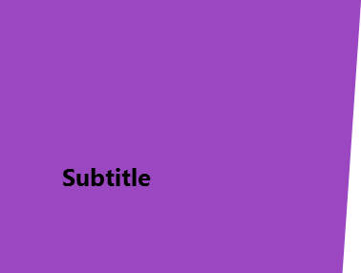

Hosting Plans
Readify helps customers succeed by developing and supporting innovative software projects that solve business problems.
Subtitle
Strategy
Design
Deliver
Sustain
Enterprise Architecture
Platform Selection
Business optimisation
Emerging trends
Roadmap
Architecture
UX
UI
Branding
User adoption
Software development
Application Integration
Platform deployment
Business Intelligence / Big Data
Cloud
Mobility
Project Management Services
Support
Mentoring
Training

Slide 18
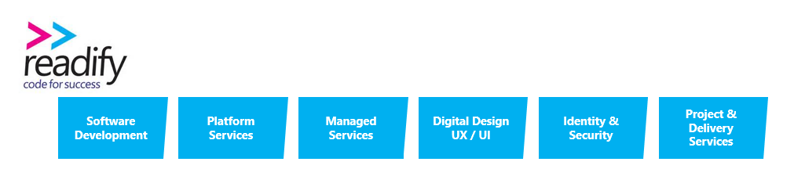
Triggers and Bindings

Slide 19
Demo in Azure Portal

Slide 20
Visual Studio 2017 tooling improvements
Notes:
Local Listed:
Oakton
Empired
SMS
DWS
Technology One
Data#3
Global Listed:
DiData
Fujitsu
IBM GS

Slide 21
Local Debugging
Customers value our capacity to understand their business and apply our software expertise to consistently deliver great results, and great value, every time.
Our ability to help customers is a direct result of applying best practice software development processes and employing elite developers.
We do this through a rigorous, peer-driven recruitment process and then continue to invest in our people's development; ensuring their skills remain at the forefront of industry knowledge. Customers gain confidence from Readify's knowledge and mastery of constantly changing subject matter.

Slide 22
Remote Debugging

Slide 23
Conclusion
There is a new reality where technology and software is a fundamental business service.
Readify is a differentiated software services player with a long and outstanding track record of profitability and sustainable growth.
Compelling market fundamentals underpinning strong growth, including increased investment in mobile applications, data analytics, and the cloud.
Differentiated through its renowned technologists and disruptive solutions, not just resources for legacy projects.
A loyal annuity customer base where 85% of revenues from repeat customers (c.50% of revenues from customers of 5+ years).
Impressive organic revenue growth (c.20%+) since 2007 delivered by a highly capable team.
A leader amongst leaders with numerous industry accolades.

Slide 24
Useful Links "“The dream as conceived 25 years ago has not been achieved. Until software becomes the ultimate tool for collaboration, productivity, and efficiency, the work is not done. And there's nothing more fun than doing that work.”
Larry Page
Notes:
That why we are talking to you.

